Slide 1
Algorithms & Data Structures
Text Mining Tries, KD-Trees & Workshop Week 1
Jacob Trier Frederiksen & Anders Kalhauge
Spring 2019

Slide 2
Program, Week 18
Test Exam & solution suggestion; hand-back
Overview: the last weeks of the course
Final Exam: information and clearing occasional questions
Project 5:
overview
choosing project
hand-out
Two last theortical bits:
Text Mining, ‘Tries’ (Ch. 5.2)
kD-Trees, (con amore -- but part of one project 5 choice)

Slide 3
Program, Week 18
Test Exam & solution suggestion; hand-back
Overview: the last weeks of the course
Final Exam: information and clearing occasional questions
Project 5:
overview
choosing project
hand-out
Two last theortical bits:
Text Mining, ‘Tries’ (Ch. 5.2)
kD-Trees, (con amore -- but part of one project 5 choice)

Slide 4
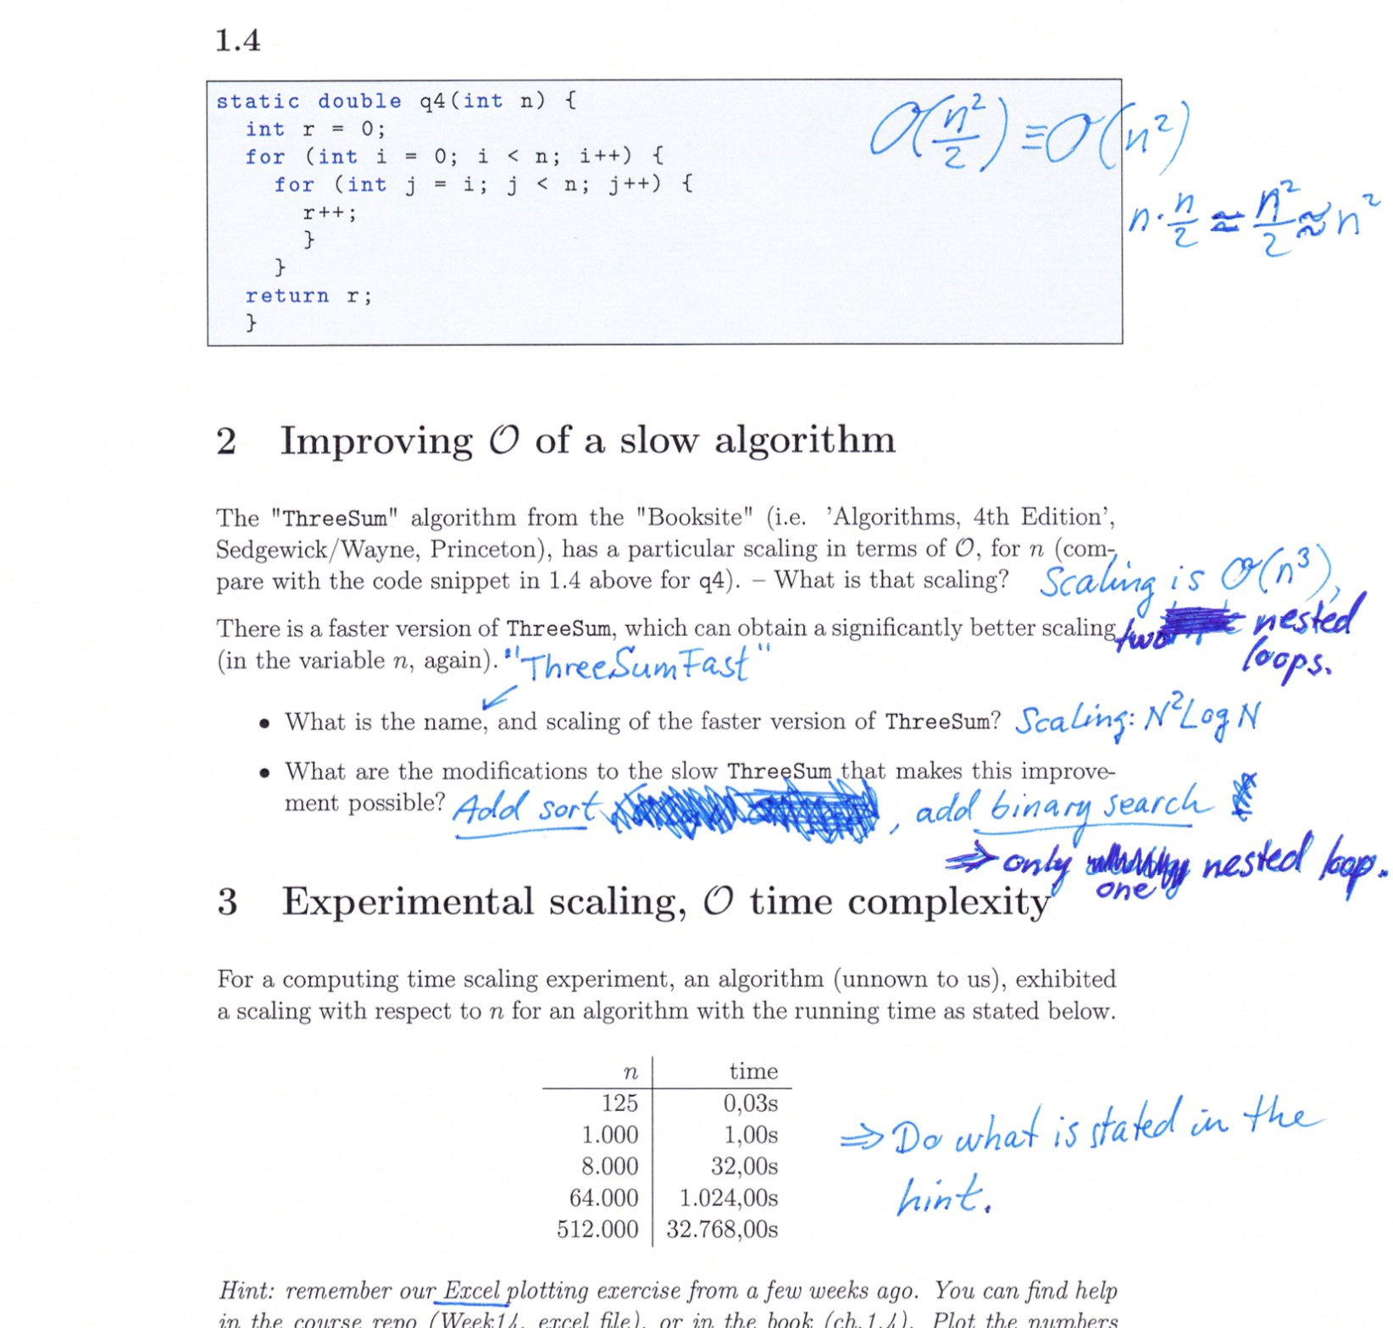
Test Exam & solution suggestion; hand-back
NB: This was an exercise, which we decided to do
NB: It is not graded
NB: Meant only as an indicator of your standing on knowledge
NB: There is still time before the finals

Slide 5
Program, Week 18
Test Exam & solution suggestion; hand-back
Overview: the last weeks of the course
Final Exam: information and clearing occasional questions
Project 5:
overview
choosing project
hand-out
Two last theortical bits:
Text Mining, ‘Tries’ (Ch. 5.2)
kD-Trees, (con amore -- but part of one project 5 choice)

Slide 6
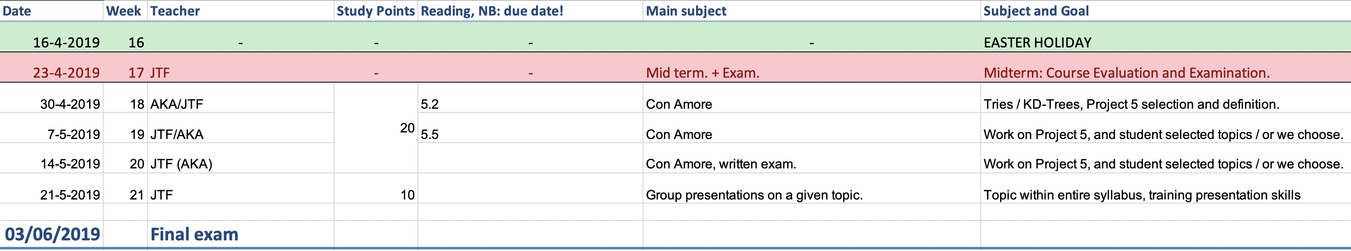
Overview: the last weeks of the course – ‘Looking for the summer...’ [Chris Rea]

Slide 7
Program, Week 18
Test Exam & solution suggestion; hand-back
Overview: the last weeks of the course
Final Exam: information and clearing occasional questions
Project 5:
overview
choosing project
hand-out
Two last theortical bits:
Text Mining, ‘Tries’ (Ch. 5.2)
kD-Trees, (con amore -- but part of one project 5 choice)

Slide 8
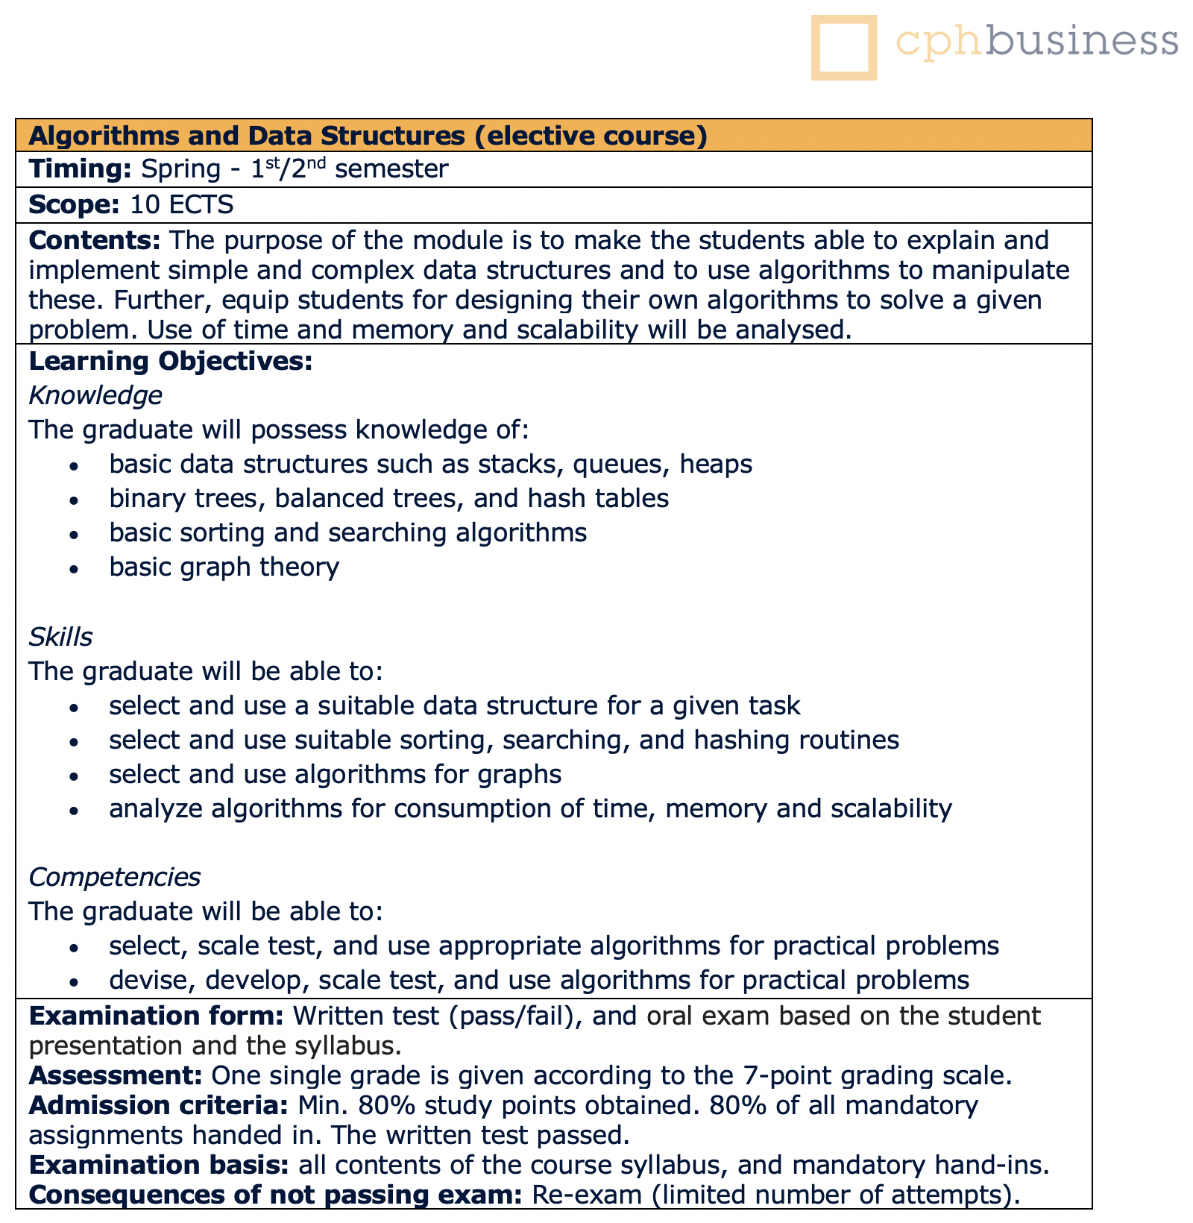
Final Exam: information
Information from the Course Catalogue

Slide 9
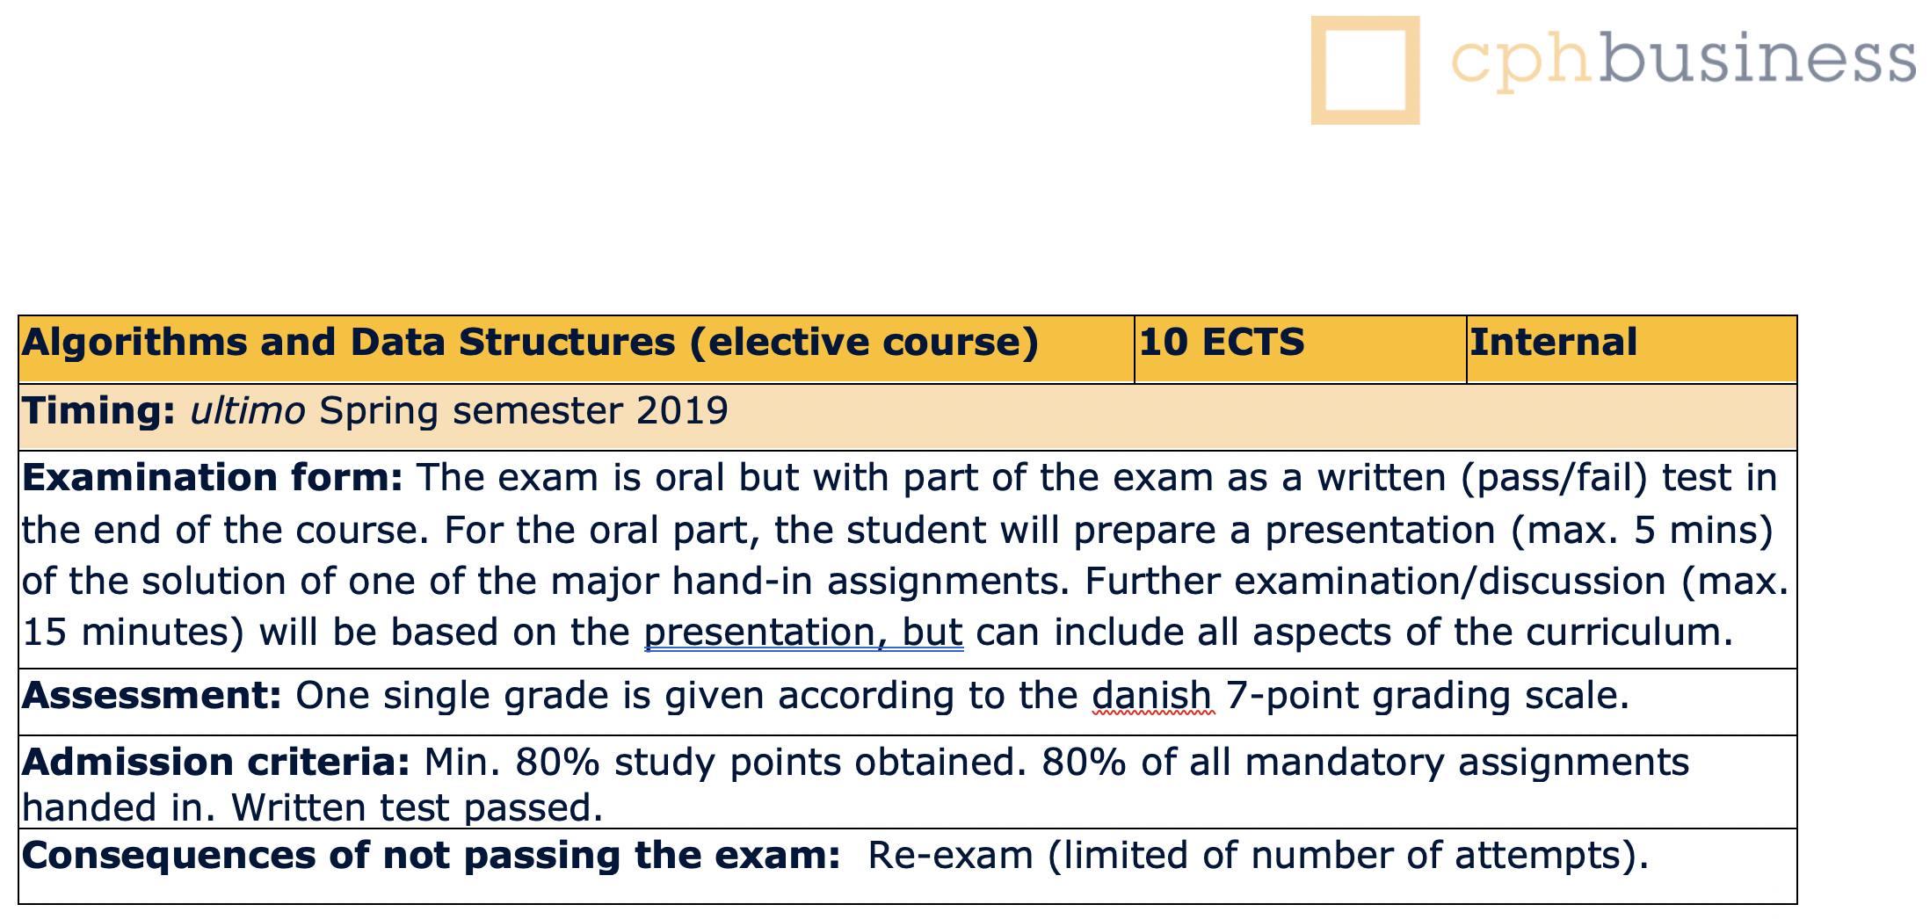
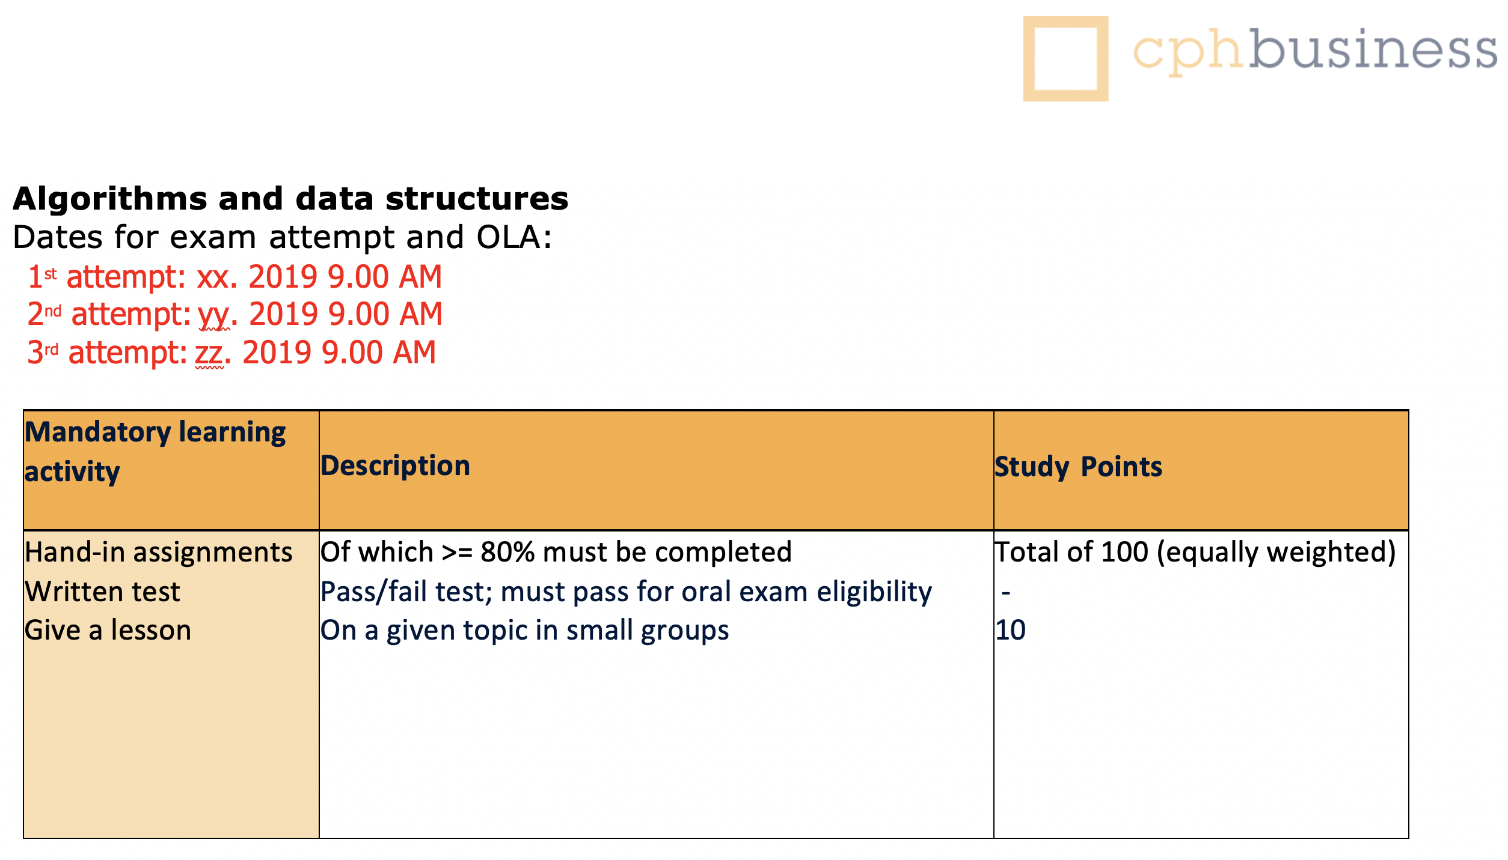
Final Exam: clearing occasional questions
Exam details
Study Points

Slide 10
Program, Week 18
Test Exam & solution suggestion; hand-back
Overview: the last weeks of the course
Final Exam: information and clearing occasional questions
Project 5:
overview
choosing project
hand-out
Two last theortical bits:
Text Mining, ‘Tries’ (Ch. 5.2)
kD-Trees, (con amore -- but part of one project 5 choice)

Slide 11
Project 5 – reaching a level of independence...
You get to choose your topic (from a list of four):
Out-of-core Sorting of ‘Big Data’
Text Mining, using Tries for sorting ‘Big Data’
Error detection/correction in sorting of ‘Big Data’
kD-Tree acceleration, searching kD spaces w/applications

Slide 12
Program, Week 18
Test Exam & solution suggestion; hand-back
Overview: the last weeks of the course
Final Exam: information and clearing occasional questions
Project 5:
overview
choosing project
hand-out
Two last theortical bits:
Text Mining, ‘Tries’ (Ch. 5.2)
kD-Trees, (con amore -- but part of one project 5 choice)

Slide 13
Text Mining
‘Tries’ by Anders Kalhauge
Relevant in particular for project 5 on text mining
Relevant generally for exam and in real ”IT Life” ☺

Slide 14
Program, Week 18
Test Exam & solution suggestion; hand-back
Overview: the last weeks of the course
Final Exam: information and clearing occasional questions
Project 5:
overview
choosing project
hand-out
Two last theortical bits:
Text Mining, ‘Tries’ (Ch. 5.2)
kD-Trees, (con amore -- but part of one project 5 choice)

Slide 15
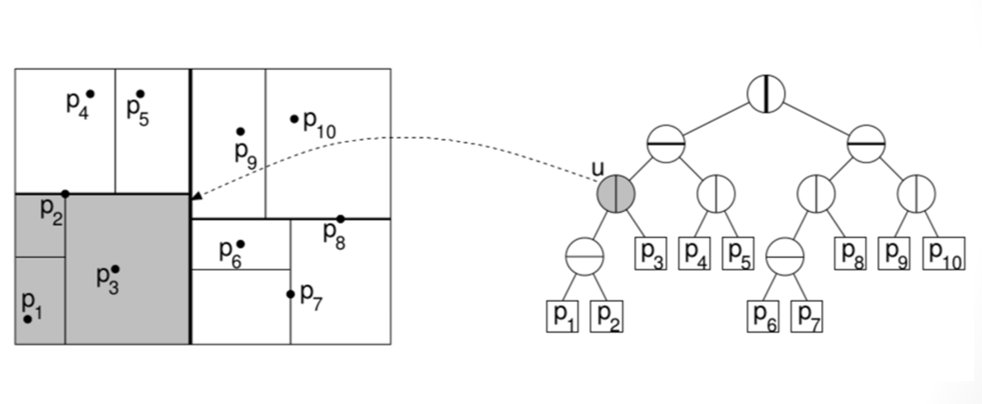
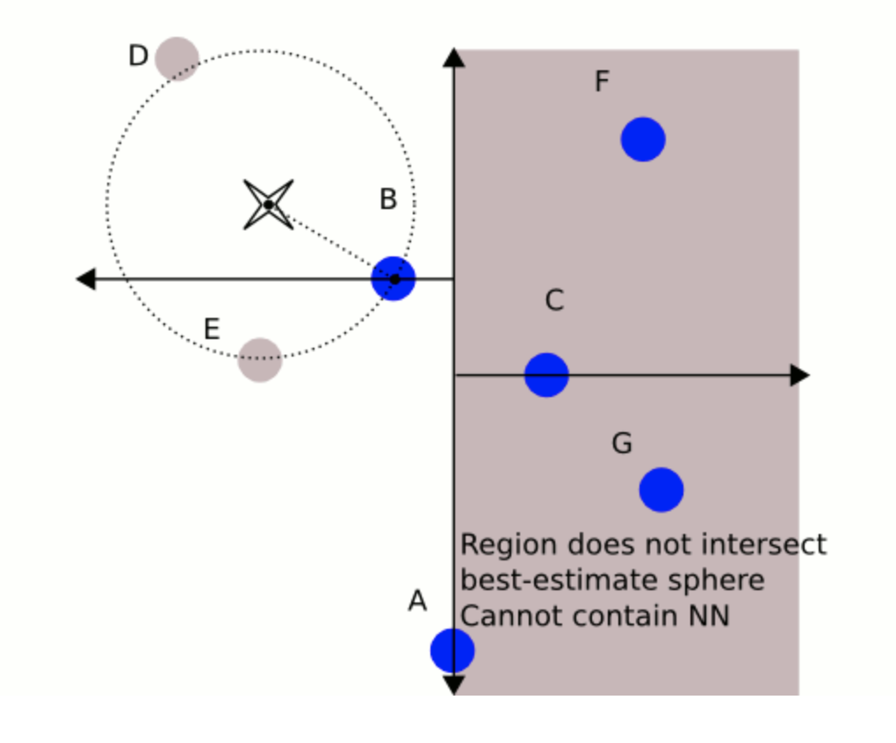
kD-Trees (here just 2D but more general) (con amore, but part of project 5 option)
This is the first of two formal slides on kD-Trees, today.
The rest will be free wheeling, or ”winging it”, with some interesting applications in sight.
Oct-tree (for 3D, e.g.)
Quad-tree (2D, e.g.)
Nearest neighbor search

Slide 16
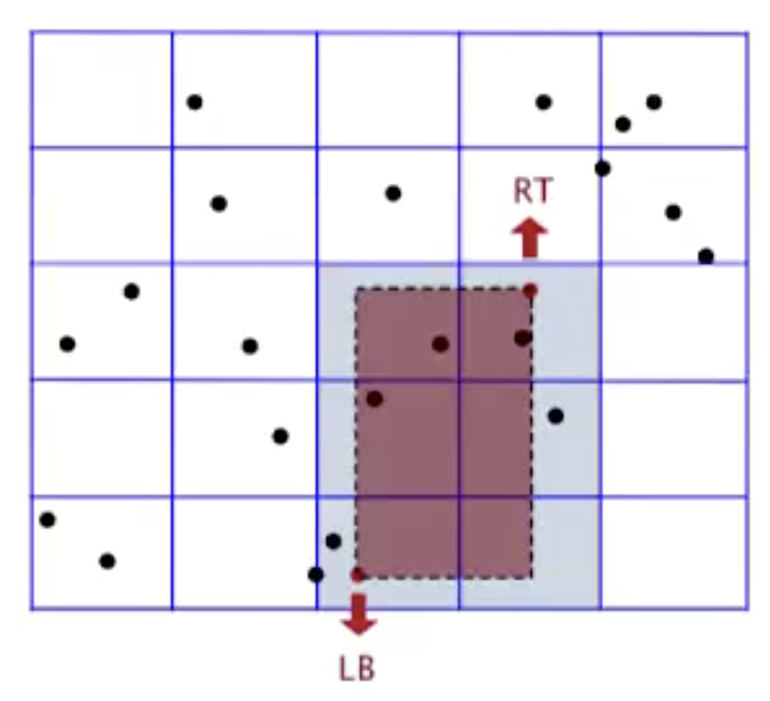
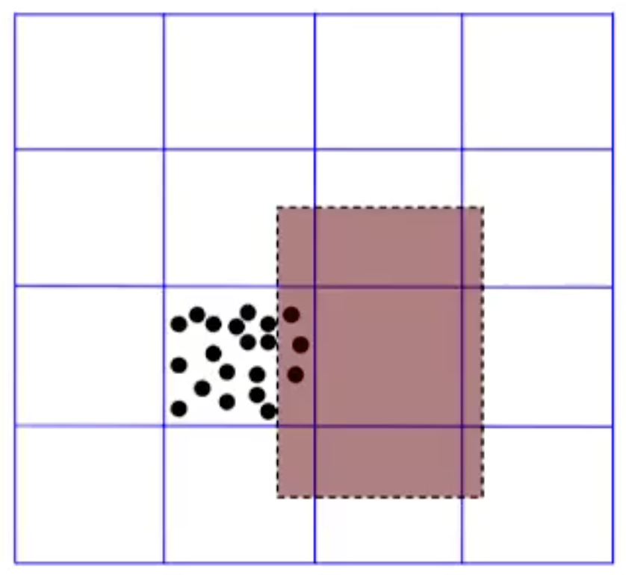
Naiive Particle Model
Space: O(M² + N)
Time: O(1 + N/M²)
The idea
The problem

Slide 17
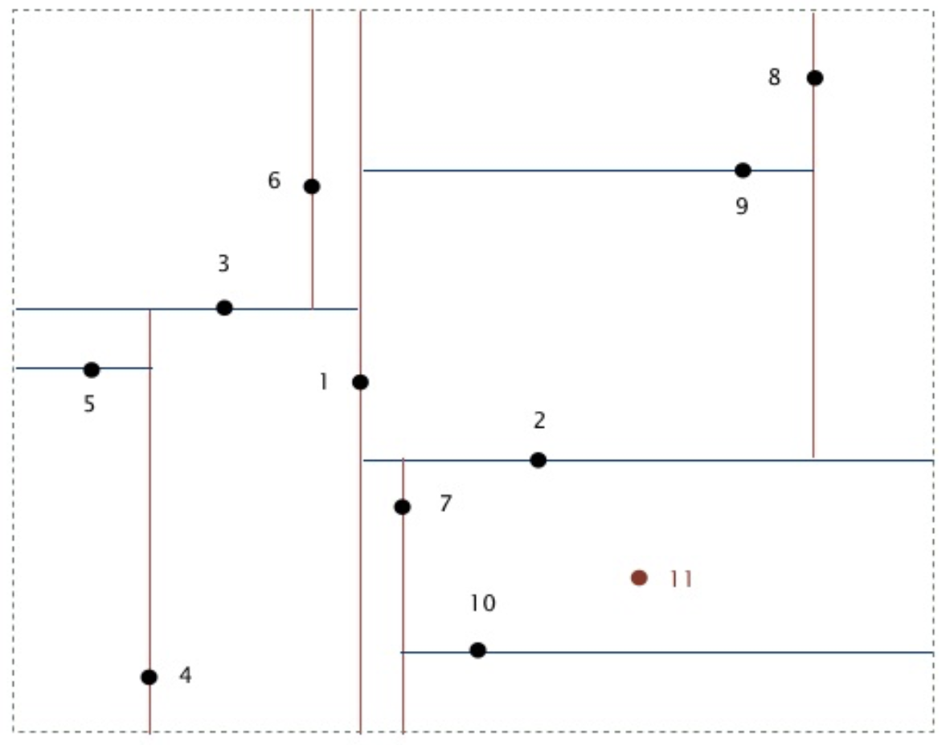
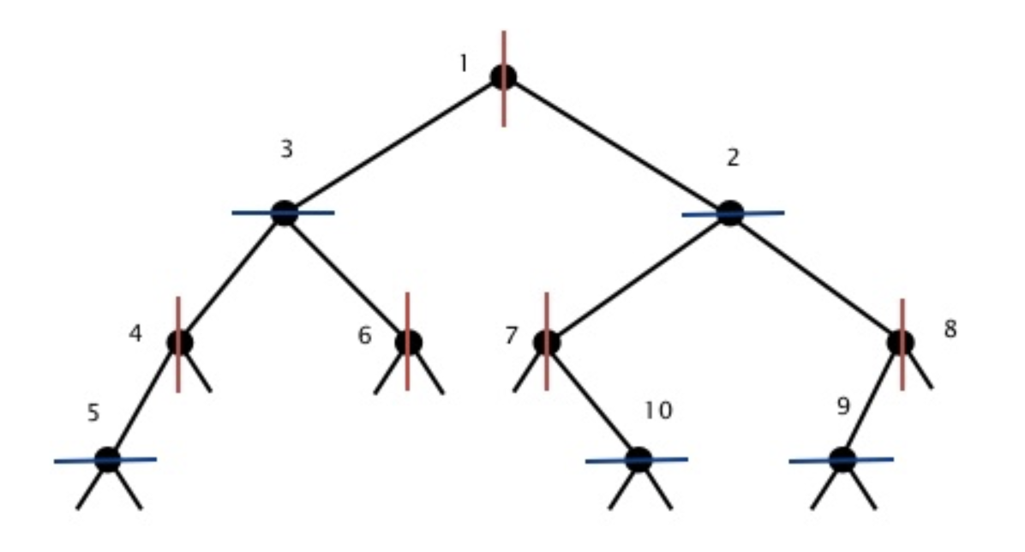
Pop!
Where should we put ‘11’ in the quad-tree?

Slide 18
kD-Trees (here just 2D but more general) (con amore, but part of project 5 option)
This is the first of two formal slides on kD-Trees, today.
The rest will be free wheeling, or ”winging it”, with some interesting applications in sight.
Oct-tree (for 3D, e.g.)
Quad-tree (2D, e.g.)
Nearest neighbor search

Slide 19
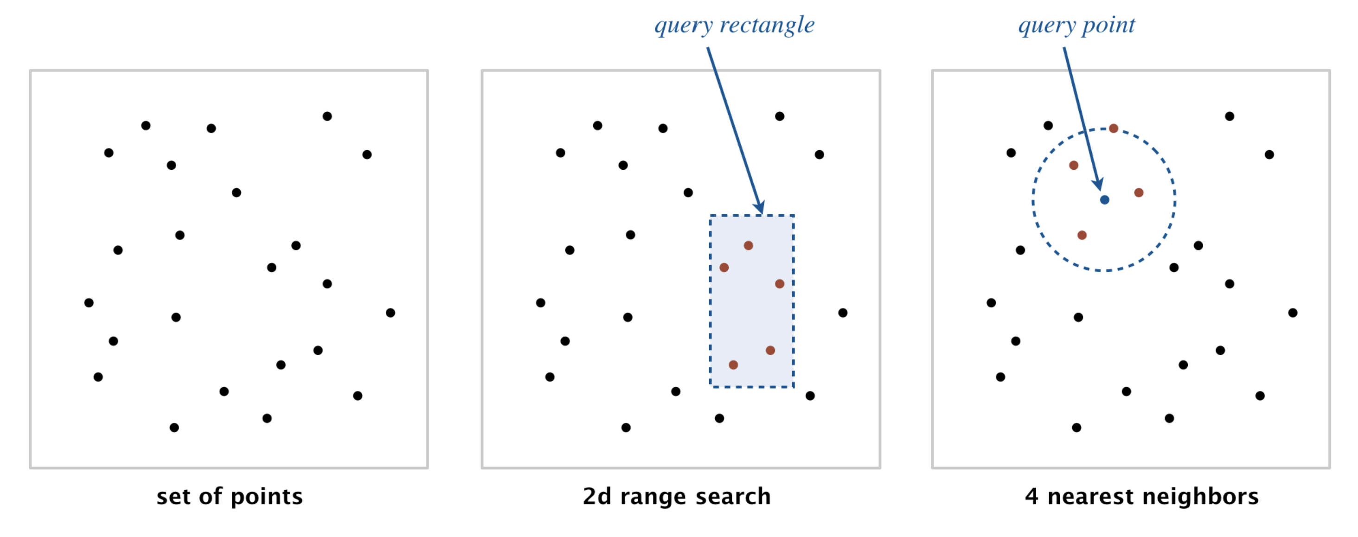
kD-Trees (here just 2D but more general) (con amore, but part of project 5 option)
This is the first of two formal slides on kD-Trees, today.
The rest will be free wheeling, or ”winging it”, with some interesting applications in sight.
Oct-tree (for 3D, e.g.)
Quad-tree (2D, e.g.)
Nearest neighbor search

